Slide 1

Høgskolen i Telemark
Telemark University College
Presentation at
"Servomøtet", Trondheim, 21 - 22 October 2015
Control of
Biogas Reactors
Finn Aakre Haugen
Telemark University College, Norway

Slide 2
Agenda:
Introduction to biogas reactors
Control aims and control variables of biogas reactors
A case study: A pilot plant at Foss farm, Skien
  Online monitoring using Kalman-filter
  Control of biogas production
  Optimization of design and operation a planned full-scale reactor at the farm
A survey of biogas reactors in Norway
A planned installation of an online analysator at a waste water treatment plant (WWTP)
Conclusions

Slide 3
What is a biogas reactor?

Slide 4
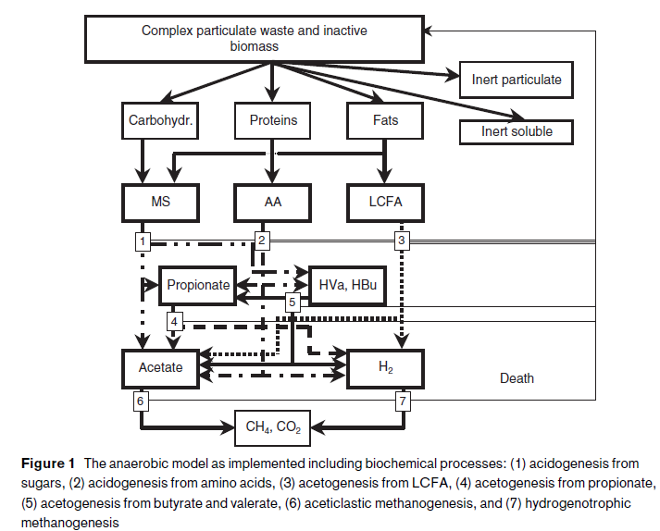
The AD processes:
(Batstone et al., 2002)

Slide 5
Possible products from the reactor
75%
40%
45%
85%
40%
≈ Diesel
50%
35%
Based on (Deublein et al., 2010)
Numbers: Efficiency.

Slide 6
Alternative control aims of
biogas reactors:
Specified biogas production (flow).
(Energy content of methane is approx. 10 kWh/m3.)
Non-controlled biogas production (using constant feed rate), but certain constraints must be satisfied:
  Constraint: CH4 concentration > 55%
  Constraint: 6.5 < pH < 7.6
  Constraint: Alkalinity ratio: AR = VFA/Alkalinity < 0.3
  Constraint: VFA < 1 g/L
(Drosg, 2013)
(Labatut, 2012)
(Deublein, 2010)

Slide 7
Alternative control variables:
Feed rate (flow)
Addition of bicarbonate (to counteract decrease in alkalinity caused by e.g. VFA accumulation)
Addition of ferrous and ferric chloride with added micro nutrients (BDP) to increase the biogas yield and capacity of the anaerobic digester
Reactor temperature

Slide 8
Case study:
Pilot reactor at Foss farm:
Automatic PI control of
CH4 gas production
(Haugen et al., 2013a)

Slide 9
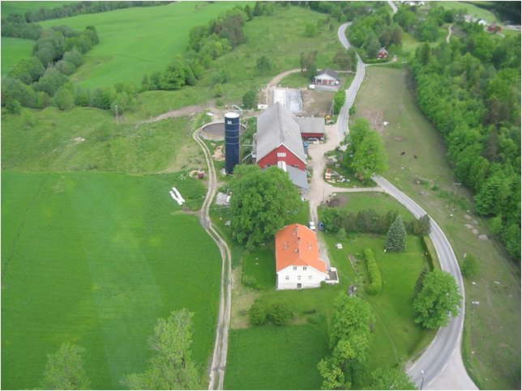
Foss Farm (Skien, Norway)

Slide 10
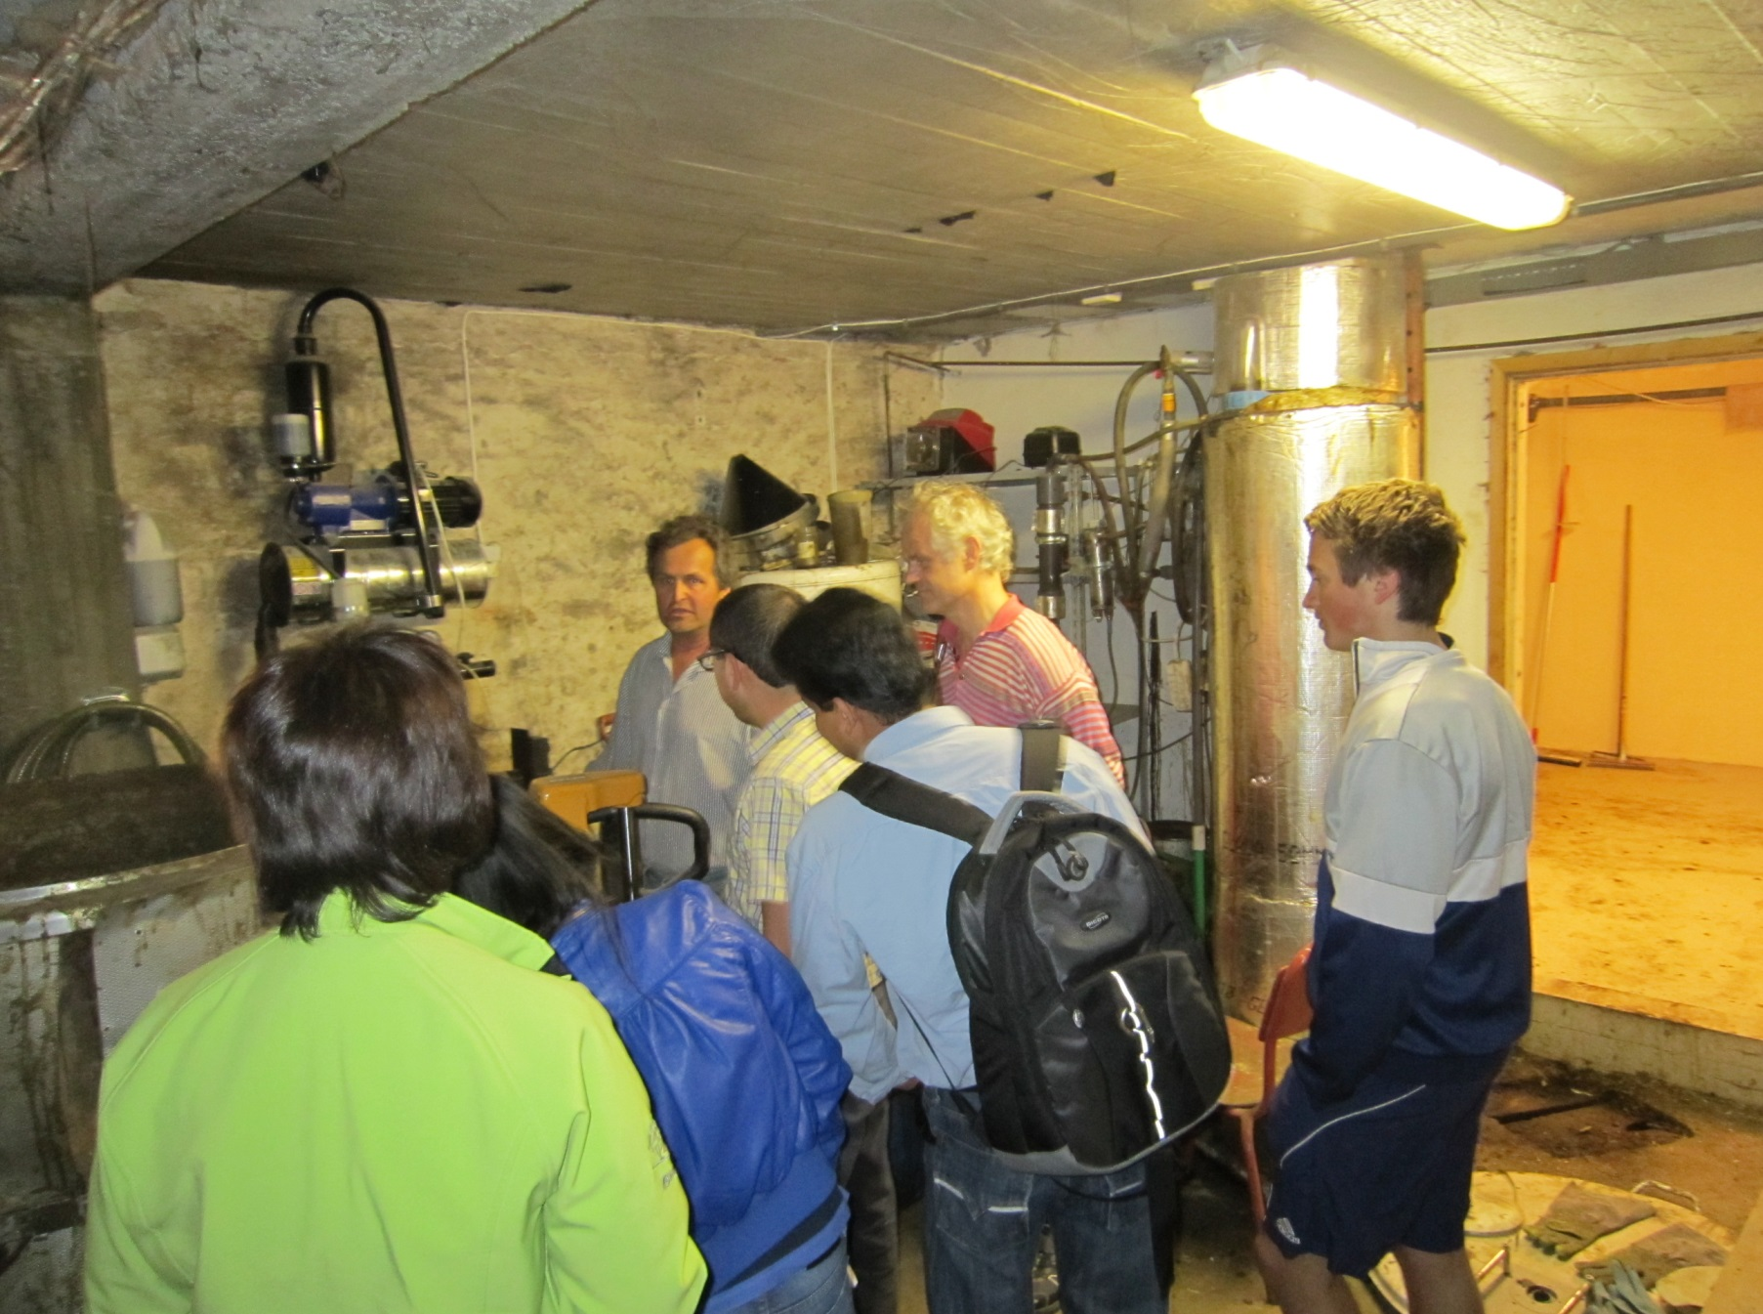
Foss Biolab (in the barn)

Slide 11
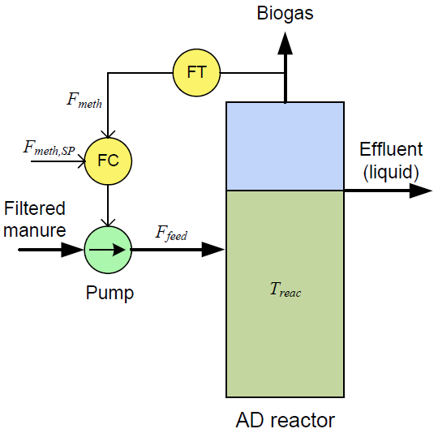
AD reactor with control system for Fmeth:

Slide 12

Benefit of automatic control of CH4 gas flow
(PI controller is used here):
With autom. control
Without control

Slide 13
Case study:
Pilot reactor at Foss farm:
Model-based reactor monitoring and CH4 gas production control
(Haugen et al., 2014)

Slide 14
Structure of general model-based control system

Slide 15
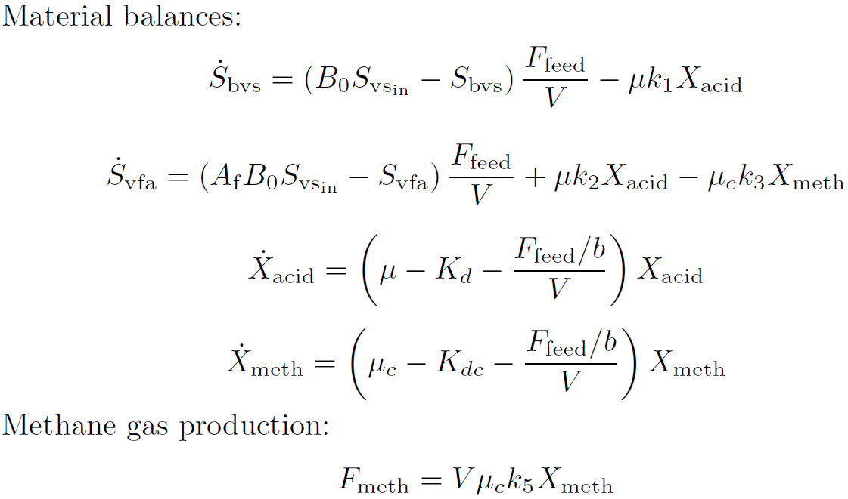
AD model used: «Modified Hill model»*
* D. T. Hill, “Simplified monod kinetics of methane fermentation of animal wastes,” Agricultural Wastes, vol. 5, no. 1,pp. 1–16, 1983
(Haugen et al., 2013)

Slide 16
Results with Kalman Filter (Unscented KF):

Slide 17
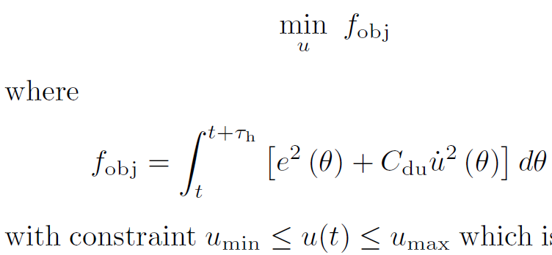

Predictive controller
(implemented in a MATLAB node in LabVIEW)

Slide 18
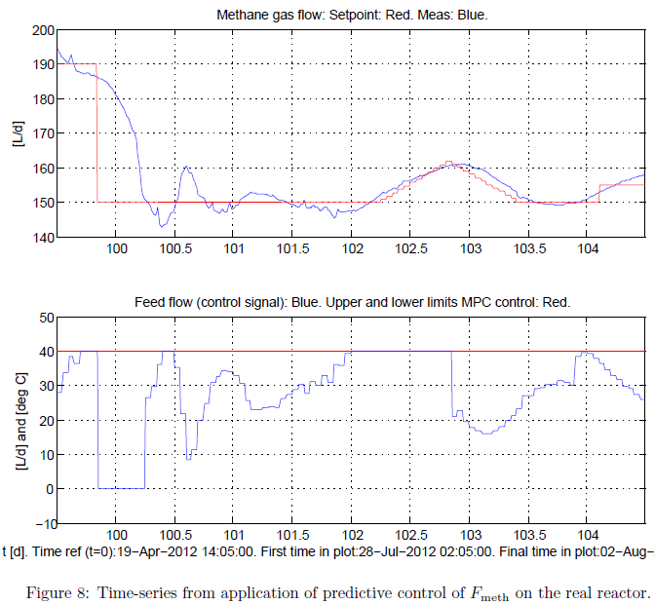
Predictive control of real reactor:
Fmeth:
Feed flow (u):

Slide 19
Case study:
Foss farm:
Model-based optimal design and operation of a planned full-scale reactor at Foss farm
(Haugen et al., 2015)

Slide 20
AD reactor with auxilliary devices:

Slide 21

Optimization problems:
Max = ?
Min = ?
(or objective
functions)
Max = ?

Slide 22
Ranges assumed:
Ffeed between 0 and 4.2 m3/d (all manure being used).
Reactor volume V between 0 and 700 m3.
B = SRT/HRT between 1 and 20.
Svfa between 0 and 0.8 g/L.
ghx (heat transfer coefficient of heat exchanger):
Value ghx = infinity means perfect heat ex.
Value ghx = 0 means no heat ex.
U (heat transfer coefficient of AD reactor:
Value U = 6.5e4 is estimated on real reactor.
Value U = 0 means isolated reactor.

Slide 23
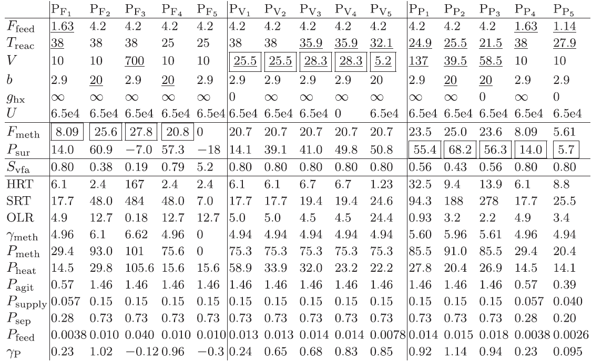
Various optimization problems:
Underlined: Optim variable. Framed: Optim result (output). Encircled values: The example on following slides.
Max Fmeth [m3/d]
Min V [m3]
Max Psurplus [MWh/y]

Slide 24
Units in the table:
Ffeed [m3/d]
Fmeth [m3/d]
V [m3]
Svfa [g/L]
P [MWh/y]
HRT [d]
OLR [kg VS m3 d^-1]

Slide 25
An example (optim. scenario Pp1 in the table):

Slide 26
Examples of results of optimization:
PF1: V = 10 (fixed). Max Fmeth is obtained with Ffeed = 1.63, i.e. waste is wasted!, and T=38.
PF3: T = 38 (fixed). Max Fmeth is obtained with Ffeed = 4.2 (no waste is wasted) and V=700 (max allowed). Note: Psur is negative!
PV1 vs PV2 shows that Psur is increased by using heat ex between effluent and influent.
PV3 vs PV5 shows that V can be reduced if SRT is increased.

Slide 27
Another possible application of an AD model:
How to operate the reactor to recover reactor "health" in case of process setups?
Optimization using a dynamic model may show how to operate the reactor!
Probably, a more complicated model than Hill's model should be used, e.g. the ADM1 (Anaerobic Digestion Model no. 1) (Batstone et al., 2002)
(Topic to be studied further...)

Slide 28
A survey of
monitoring and control
at largest biogas plants in Norway
The list of plants is based on (KLIF, 2013).

Slide 30
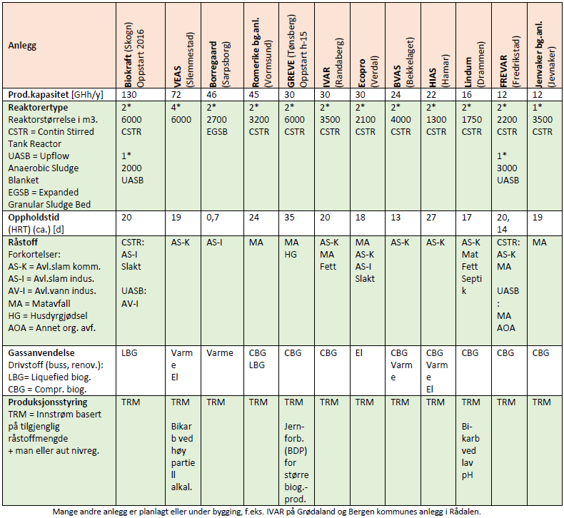

Slide 31
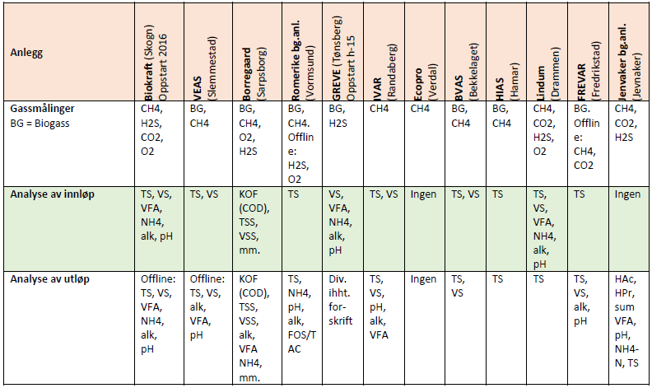

Slide 32
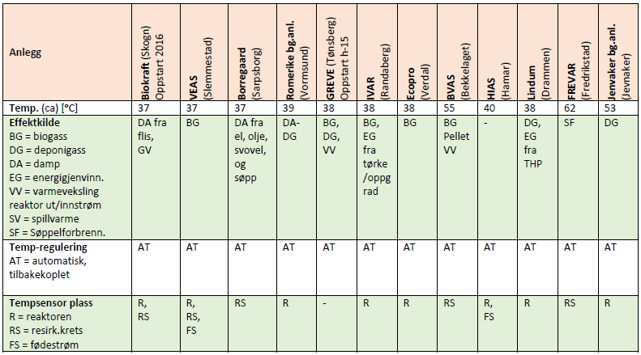

Slide 33
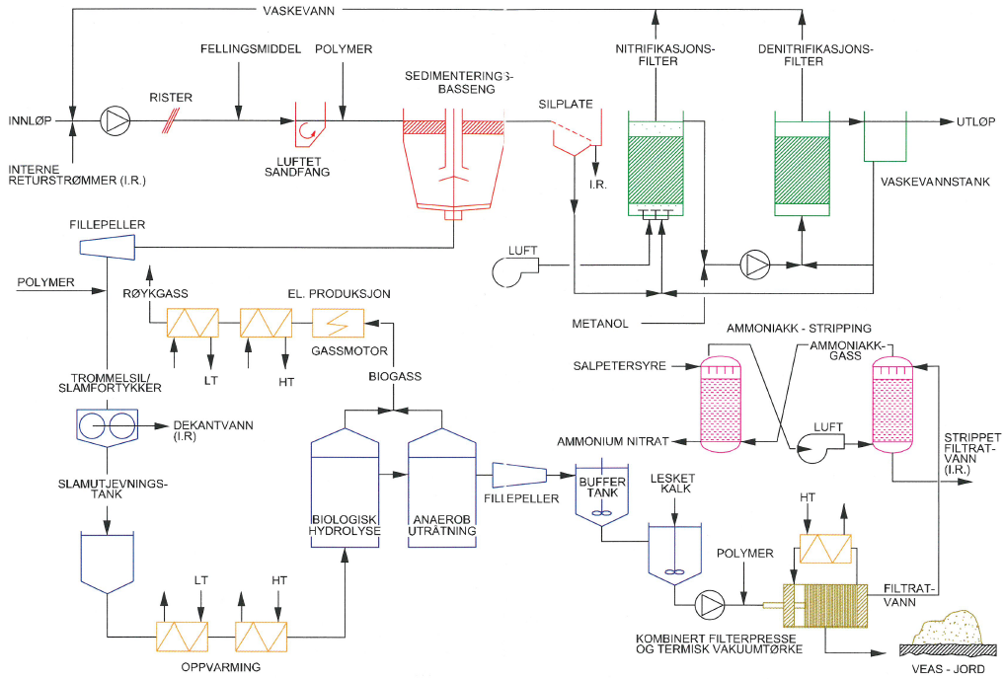
Planned installation of an online analysator at VEAS

Slide 34
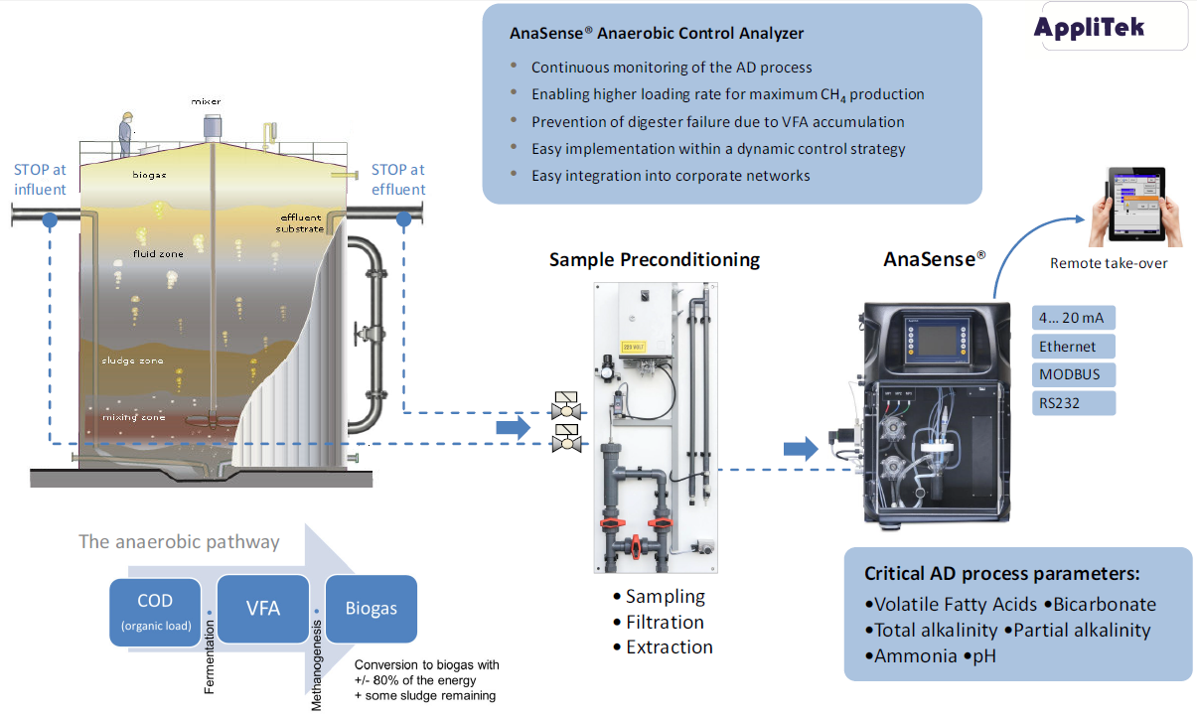

Slide 35
Possible uses of the analysator:
Monitor the reactor state ("health") online.
Obtain continuous data for subsequent adaption of appropriate mathematical models
Feedback control of alkalinity ratio and/or VFA concentration
Continuously updating a model-based soft-sensor (i.e. a state estimator in the form of a Kalman filter)

Slide 36
Conclusions
Although fully possible to implement (as demonstrated in the pilot plant case study), in industrial applications, feed flow (influent) to reactor is typically kept mainly constant, equal to the flow of available organic waste to be processed. So, feed flow is not used as a control variable.
In industrial applications, online monitoring of gas flow and composition is common.
In industrial applications, online monitoring of reactor digestate (effluent) is not common.
If a dynamic mechanistic model has been successfully adapted, it can be used for:
  Online monitoring using a Kalman filter
  Optimization of operation and design of the reactor
  Optimal recovery of reactor "health" (to be studied further)

Slide 37
References
Arnøy, S., Møller, H., Modahl, I. S., Sørby, I., Hanssen, O. J., (2013). Biogassproduksjon i Østfold - Analyse av klimanytte og økonomi i et verdikjedeperspektiv. (In Norwegian.) (English title: Biogas production in Østfold – Analysis of climate effects and economy from a life cycle perspective.) Østfoldforskning (Ostfold Research, Norway). Report no. OR.01.13.
Batstone, D. J., Keller, J. , Angelidaki, I., Kalyuzhnyi, S. V., Pavlovstahis, S. G., Rozzi, A., Sanders, W. T. M., Siegrist, H., Vavilin, V. A. (2002). Anaerobic Digestion Model No. 1. Scienific and Technical Report, 15, IWA Publising.
Bernard, O., Hadj-Sadok, Z., Dochain, D., Genovesi, A., Steyer, J.-P. (2001). Dynamical Model Development and Parameter Identification for an Anaerobic Wastewater Treatment Process. Biotechnology and Bioengineering, 75 (4).
Deublein, D., Steinhauser, A., (2010). Biogas from Waste and Renewable Resources, Wiley.
Drosg, B. 2013. Process monitoring in biogas plants. IAE Biotechnology.
Haugen, F., R. Bakke and B. Lie. (2013). Adapting dynamic mathematical models to a pilot anaerobic digestion reactor, Modeling, Identification and Control, 34 (2).
Haugen, F. and B. Lie. (2013a). On-off and PID Control of Methane Gas Production of a Pilot Anaerobic Digestion Reactor. Modeling, Identification and Control, 34 (3).
Haugen F., R. Bakke and B. Lie. (2014). State Estimation and Model-based Control of a Pilot Anaerobic Digestion Reactor. Journal of Control Science and Engineering, 14.
Haugen F., R. Bakke, B. Lie, K. Vasdal and J. Hovland. (2015). Optimal Design and Operation of a UASB Reactor for Dairy Cattle Manure. Computers and Electronics in Agriculture, pp. 203-213.
Klima- og forurensningsdirektoratet (KLIF). (2013). Underlagsmateriale til tverrsektoriell biogass-strategi.
Labatut R., Gooch C. (2012). Monitoring of Anaerobic Digestion Process to Optimize Performance and Prevent System Failure, Proceedings of Got Manure? Enhancing Environmental and Economic Sustainability, 209-225.

Slide 38
Thank you for your attention

